Slide 2
Canine Rehabilitation Ruth Schmidtchen, MS, DVM, CCRP, CVA
April Laslie, Rehabilitation Tech

Slide 3
Agility

Slide 4
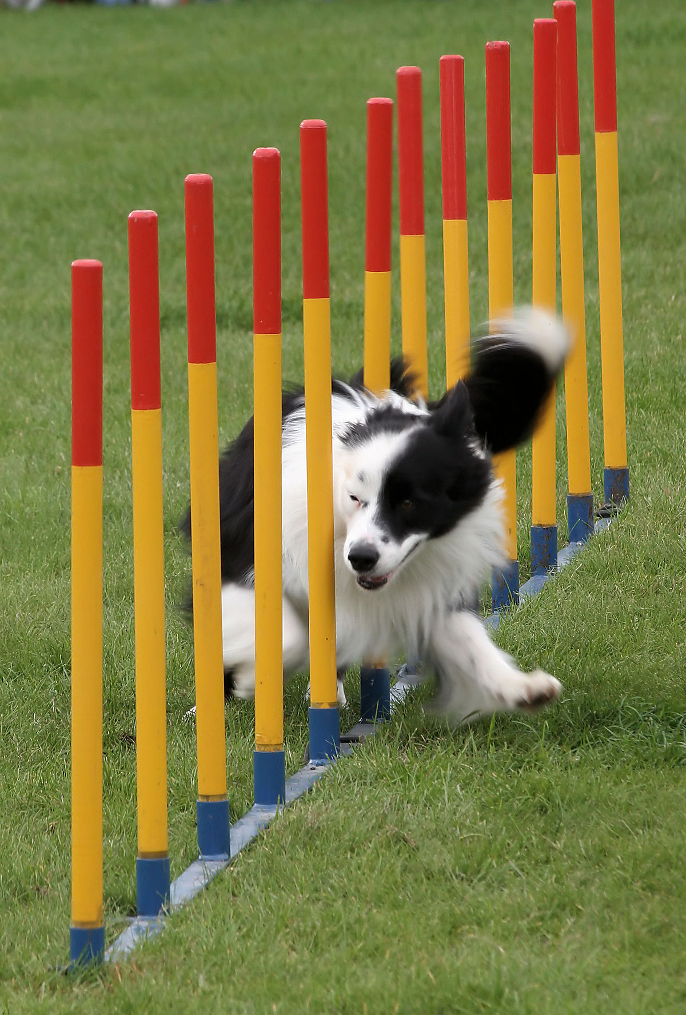
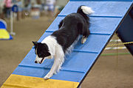
Agility

Slide 5
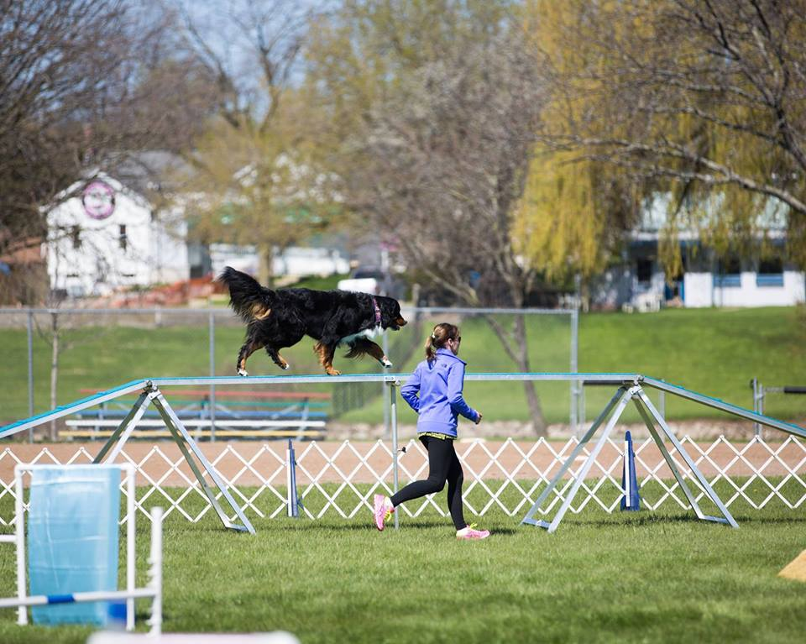
Agility

Slide 6
Agility

Slide 7
Agility

Slide 8
Agility

Slide 9
Agility

Slide 10
Skijoring
© COPYRIGHT MARS INCORPORATED

Slide 11
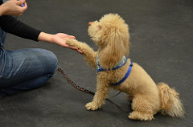
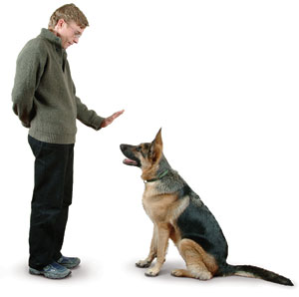
Obedience
Obedience

Slide 12
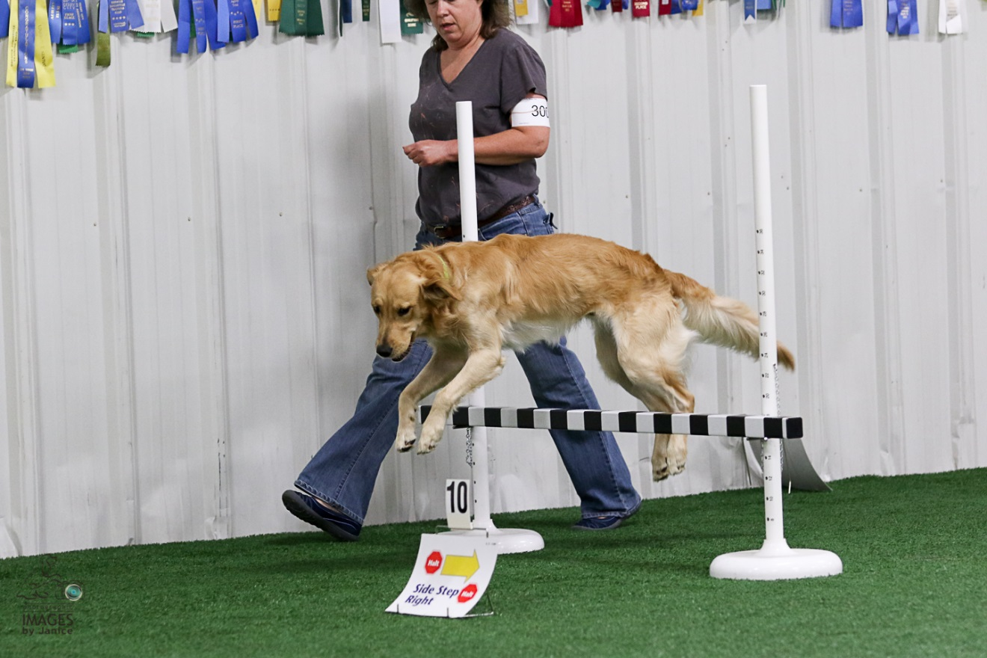
Rally

Slide 13
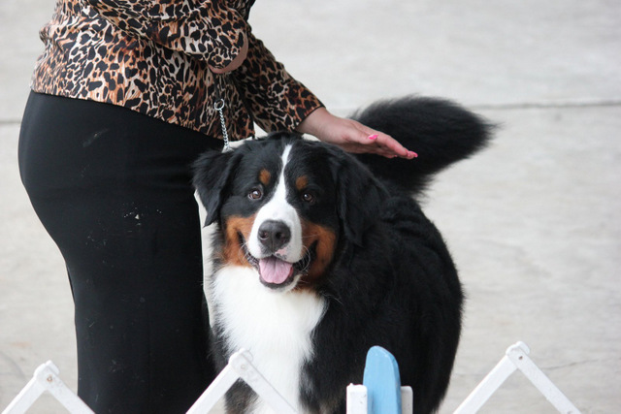
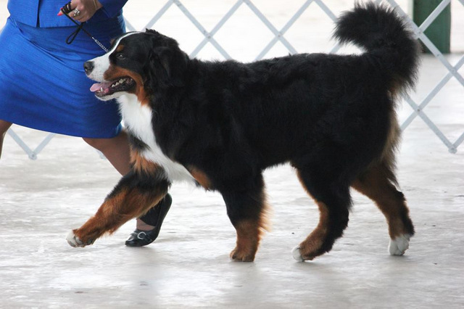
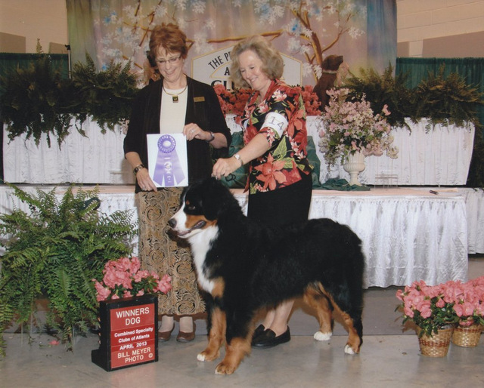
Confirmation

Slide 14
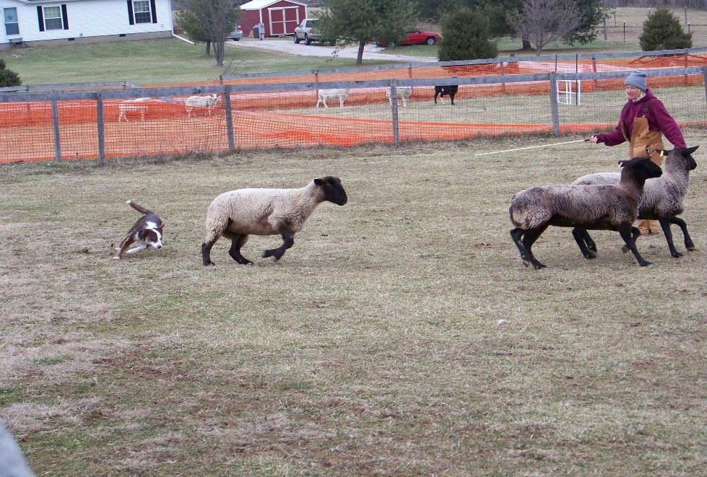
Herding

Slide 15
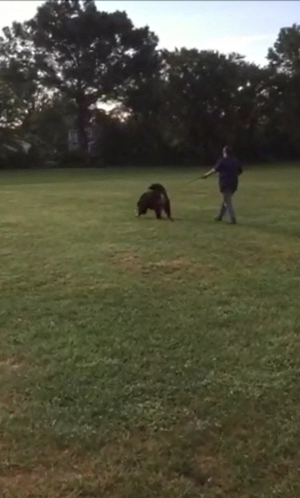
Tracking

Slide 16
Lure Coursing

Slide 17
Mushing

Slide 18
Canicross/Bikejoring

Slide 19
Field Trial/Hunt Tests

Slide 20
Flyball

Slide 21
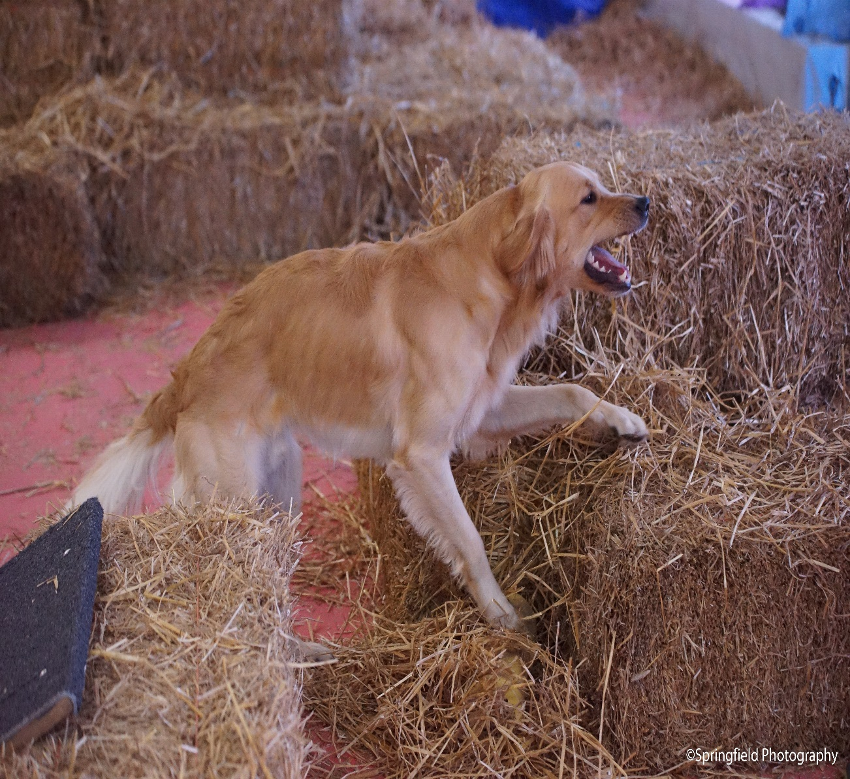
Earthdog Test/Barn Hunt

Slide 22
Dock Diving

Slide 23
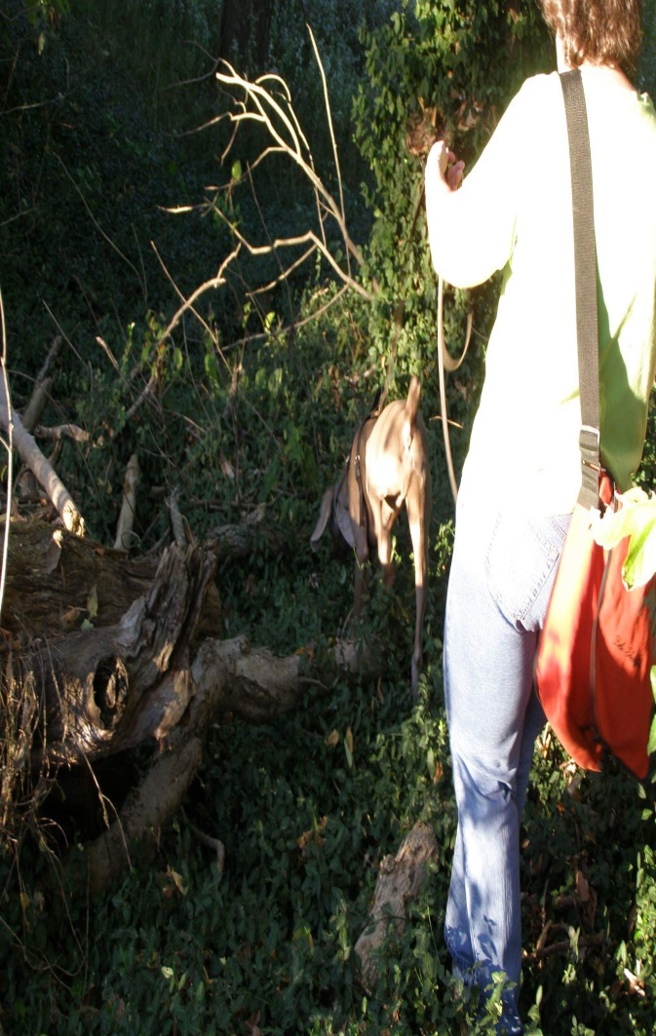
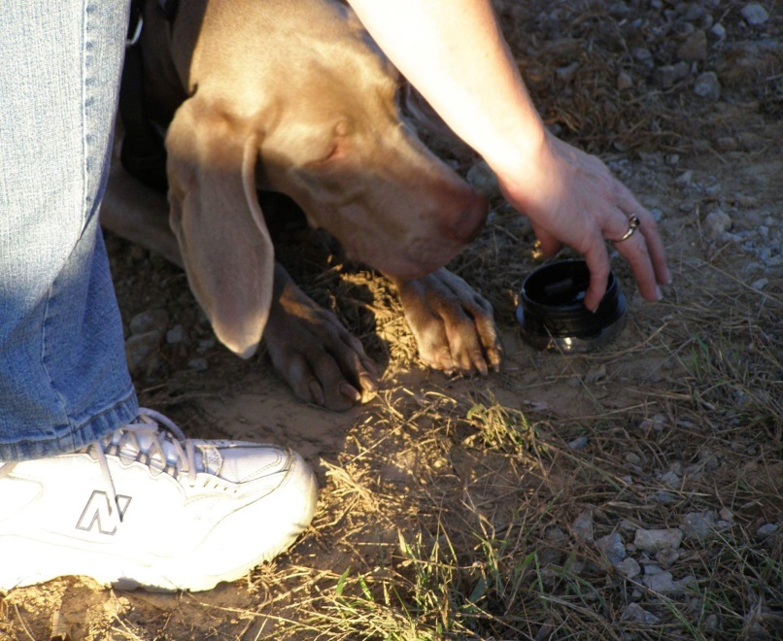
Canine Nosework

Slide 24
Detection Dogs

Slide 25
Schutzhund/French Ring Sport

Slide 26
Therapy Dogs

Slide 27
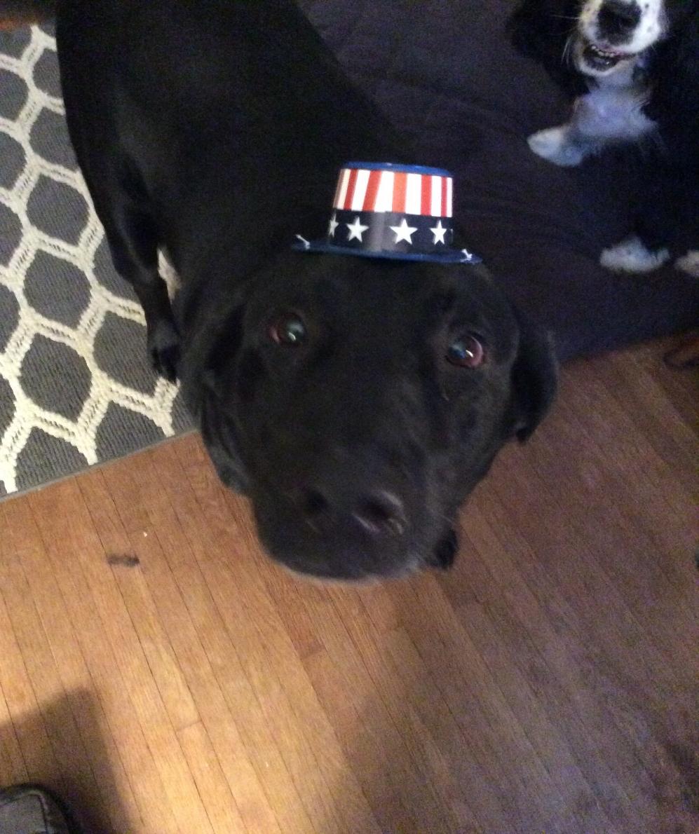
Non-competition Athletes

Slide 28
Evidence for Physical Therapy
Fastest growing branch of Veterinary medicine
Twenty years ago there was scant information in the literature, usually the dog as a model for humans
Growing interest in not only does rehab work but also why?
Useful in rehabilitation due to injury and conditioning in the canine athlete as well as return to activities of daily function

Slide 29
Rehabilitation Clients
IVDD
FCE
Fractures
Post op limb weakness
Geriatric Issues
Osteoarthritis
Hip dysplasia
Juvenile bone issues
Conditioning
Pain management

Slide 30
IVDD

Slide 31
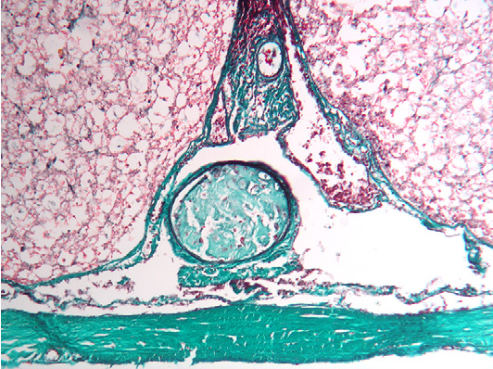
IVDD/FCE

Slide 32
Fractures

Slide 33
Hip Dysplasia

Slide 34
Osteoarthritis

Slide 35
Rehabilitation Modalities
Acupuncture
Therapeutic laser
Water treadmill
Land treadmill
Therapeutic Exercises
Stretching
Massage
Cold and heat
Electrical Stimulation
Pulsed Electromagnetic fields
Therapeutic Ultrasound

Slide 36
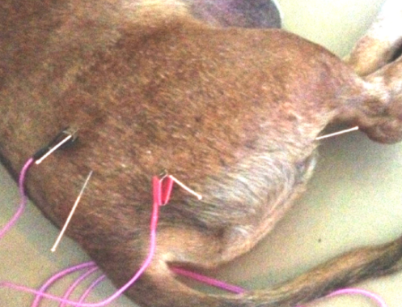
Acupuncture

Slide 37
Acupuncture
TCM (traditional Chinese medicine) such as acupuncture has been used for thousands of years to effectively treat many conditions, including pain and neurologic issues
Acupuncture is the stimulation of specific points on the body surface by insertion of a needle, resulting in a therapeutic or homeostatic effect
Acupuncture points are found in areas with a high density of mast cells, lymphatics and arteriovenous plexi as well as increased innervation
Stimulation of these points causes release of proinflammatory factors such as interleukin-6, cyclooxygenase-2, tumor necrosis factor, and beta-endorphins.
Endorphins promote a profound and long-term analgesic effect
Certain acupoints can reduce the damage of free radicals and improve microcirculation

Slide 38
Acupuncture continued
Stimulation of acupoints can be achieved by various techniques: dry needle (DN), electroacupuncture (EA), aqua-acupuncture (AA), and moxibustion.
DN is the most commonly used technique in veterinary acupuncture, and involves the insertion of fine, sterile needles into acupoints.
EA, the modern practice of stimulating inserted needles with electricity, has been shown to have more profound effects compared with other techniques. It is used because of its rapid onset of pain relief and its ability to stimulate peripheral nerves. It is especially useful for neuralgia, nervous system injury, and persistent pain.
AA is the injection of sterile liquids into points which may result in prolonged stimulus.
Moxibustion involves heating directly over the needle with moxa (bundled herb-mugwort). The mechanism relates to the thermal and nonthermal radiation created by the combustion products on the acupoint.

Slide 39
Acupuncture Uses
Spinal Cord injury: acupuncture has been shown to accelerate recovery of motor function and improve analgesia
Cervical spondylomyelopathy
Degenerative Myelopathy
Osteoarthritis
Epilepsy
Hip Dysplasia
FCE
Neuropathic Pain

Slide 40
Laser Therapy

Slide 41
Laser Therapy
Light Amplification by stimulated emission of radiation
The concept of the use of light for therapeutic purposes, called phototherapy, originated from the belief that the sun and other sources of light, such as infrared and ultraviolet light, have therapeutic benefit
Rehab lasers are commonly known as low-level laser therapy (LLLT), therapeutic lasers and cold laser therapy
Lasers help modulate cellular functions, a process called photo-modulation
Although the physiological effect on the tissue is still not completely understood, low-energy lasers have been reported to modulate various biological processes

Slide 42
Laser Continued
Classification of lasers is based of the wave length and the maximum output power in Watts or Energy in Joules.
Class I : mild and safe under all conditions and use (example- supermarket scanner)
Class IM: safe unless passed through a lens. They have large –diameter beams and cannot achieve the power to damage unless focused with a lens
Class 2: in the visible spectrum laser pointer
Class 3B: Most rehab lasers continuous light 315-500nm
Class 4: Some rehab , can also include surgical laser

Slide 43
Laser Continued
Lasers work by: reducing pain, reducing inflammation, promote healing
Mechanism of action: Cytochrome c is found in the cell membrane of the mitochondria and acts as a photoreceptor. Cytochrome c is critical to the formation of ATP which is essential for energy production in the cell and results in many favorable biological responses
Applications in rehab include: edema reduction, nonsurgical muscle, tendon and ligament injury, sprains and strains, nerve damage, arthritis, increase blood flow to tissues

Slide 44
Treadmill

Slide 45
Aquatic Therapy (Water Treadmill)
Works in several different ways to facilitate return to function
Warm water has the effect of warming and increasing blood supply to the submerged tissues and can produce a sensory stimulation important in spinal cases
The buoyancy of water allows painful joints to move more easily reducing loading
The hydrostatic effect or pressure of the water on the body help to reduce swelling and venous congestion in the sub-chondral bone that has been cited as a major cause of pain in arthritic joints
The viscosity of the water provides resistance to movement which is an excellent way to rebuild muscle. Resistance can also be useful to correct gait abnormalities such as those with a swaggering gait as with hip dysplasia
In a treadmill vs pool exercises, the patient is weight bearing. This pushing of the limbs through water while walking tends to build muscle quicker than by swimming

Slide 46
Land Treadmill

Slide 47
Strength Training Exercises
Forelimbs- wave, wheelbarrow, High-five, Handstand, Backing up stairs, Tugging Low, Ball-pushing, Digging
Core Muscles- Beg,Beg/wave, Crawl, Diagonal-leg standing, Stand/down/stand, Backing up stairs, Roll over/roll up an incline, Wobble board, Ball-pushing
Pelvic limbs-Beg/stand/beg, Jumping vertically, Pulling forward against a therapy band , tugging high, running up hills
Overall Strength- hiking over varied terrain, jump chutes,Cavaletti

Slide 48
Rear Leg Strength Exercises
Beg
Standing
Restraining Pulling
Hill running
Roll the peanut
Jumping
Swimming

Slide 49
Core Strength
Beg
Rollover
Down to Stand
Wobble Boards

Slide 50
Indoor Conditioning Exercises
Targets: Core, Front Legs, Rear Legs, Whole Body
Wheelbarrow
Handstand
Wave
High Five
Digging
Tugging Low
Crawling
Hi 5

Slide 51
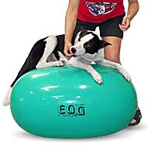
Exercise Equipment

Slide 52
Outdoor Strength Exercises
Running off leash
Tugging
Jumping
Playing and racing with other dogs
Retrieving
Trotting over cavaletti
Trotting/galloping up hills

Slide 53
Balance and proprioception
Ladder(forward and backward)
Poles on ground
Walking on 10 inch plank
Side –stepping
Walking/heeling backwards
Slow pivots
Pickup sticks
Wobble boards

Slide 54
Cryotherapy
Therapeutic application of cold. Can be applied by a variety of mechanisms including cold packs, ice massage, cold water baths, mechanical and electrical compression units, and vapo coolant sprays
Local changes can include: decrease blood flow to an area, tissue edema, hemorrhage, histamine release, local metabolism, nerve conduction velocity, pain
Time and location are important in using Cold therapy

Slide 55
Thermotherapy
Superficial of deep heating. Superficial heating penetrates 2 cm tissue depth, whereas deep heating agents elevate the temperatures of 3cm or more.
Heat sources are classified as radiant, conductive or convective
An infrared light is an example of radiant heat. A hot pack is an example of conductive heat and a whirlpool is an example of moist heat delivered by conduction and convection.
Heat application causes vasodilation, increased tissue elasticity, increased muscle relaxation, and causes pain relief.

Slide 56
Electrical Muscle Stimulation (EMS)
Referred to as Estim or NMES. These are the same thing.
EMS is sometimes referred to as TENS (transcutaneous nerve stimulation).
Both use the same machine, TENS uses completely different settings to achieve pain relief by stimulating the sensory fibers.
EMS is used to reverse or reduce muscle atrophy by stimulating muscle fibers.
EMS is useful to prevent muscle atrophy and when there already exists muscle atrophy.

Slide 57
NEMS

Slide 58
Other Therapies
Therapeutic Ultrasound-uses very high wave sound waves that are converted into kinetic energy as waves that move through tissues, most effective in high protein tissues such as ligaments
Extracorporeal Shock Wave Therapy (ESWT)-uses short bursts of high energy waves to create sudden changes in pressure, this can cause micro-fractures in the target tissue which causes inflammation and then increased growth factors and blood supply. It can also create bubbles in tissues they collapse and when this happens calcified nodules in tendons break down
Pulsed electromagnetic field therapy (PEMFT)-interferes with nerve transmission in small un-myelenated nerves, it is also thought to increase ion exchange in damaged tissues which increases oxygen usage in the cells
Hyperbaric Oxygen Therapy
Thermal Imaging- complements other imaging and diagnostic technologies, giving an immediate assessment of inflammatory, vascular, and soft tissue related conditions

Slide 59
Therapeutic Ultrasound

Slide 60
Hyperbaric Oxygen Therapy

Slide 61
Thermal Imaging

Slide 62
Manual Therapies
Umbrella term used for the therapeutic handling techniques covering soft-tissue techniques including massage, passive movements and joint mobilizations
All manual therapy techniques affect joint movement directly or indirectly by movement of the soft tissues and thus moving the joints
Massage , acts on the muscle and fascial systems as well as the nervous and circulatory systems. It has effects to reduce stress, aid the lymphatics, improve circulation, reduce muscle spasms by enhancing the elasticity and extensibility of the muscles. Massage also stimulates the delta fibers in the skin these give pain relief though the pain gate mechanism. The delta fibers are faster acting than other fibers, therefore they can close the ‘gate’ to pain.
Trigger point release- this point is a hyper-irritable focus within a taut band of skeletal muscle and located in muscular tissue and its fascia
Myofascial release-soft tissue technique where myofascial restrictions are released through sustained pressure to improve movement and reduce pain.
Passive movement of the joints (ROM)
Joint mobilization-passive repetitive rhythmical movements used to treat pain and stiffness

Slide 63
Other Therapies

Slide 64
Pain management
Pain is a complex phenomenon and involves a sensory (nocioception) and affective (emotional) component. It can also be divided into adaptive (this pain protects the body from injury and inhibiting activity) and maladaptive (reflects pathologic activity of the nervous system)
Pain can be acute- this is initiated by a traumatic, surgical or infectious event and begins abruptly and should last a predictable amount of time, correlating with the severity of the insult. It occurs when a noxious stimuli. Chronic or maladaptive pain is of long duration often accompanied by fear, anxiety and depression which can have a negative impact on the patient.
Management of Pain: medications, Acupuncture, laser therapy, movement, etc

Slide 65
Pain Management
NSAIDS:act by blocking the COX enzyme which drives production of prostaglandins (these cause inflammation and pain). Chemically they are divided into salicylates (aspirin), and carboxylic acid derivatives (carprofen, phenylbutazone, meloxicam, and coxfibs)
Opioids:result by binding of opioid receptors in the central and peripheral nervous system and GI tract. They decrease perception of and reaction to pain and are effective analgesics. Opioids have a shorter half-life requiring frequent administration. They are divided into 4 groups:full agonists (morphine, methadone, fentanyl,meperidine), agonist-antagonist (butorphanol), partial agonists (buprenorphine), and antagonists (naloxone). Tramadol is an opioid. Dogs cannot form appreciable quantities of the active metabolite and potential analgesia may be due to serotonin reuptake inhibition.
Anticonvulsants: Gabapentin works by inhibiting calcium flow to halt release of excitatory neurotransmitters, although the mechanism of analgesia is unclear
NMDA receptor antagonists: reduce pain sensation example Amantidine
Anti-depressants: Amitriptyline it blocks the NMDA-receptor antagonists, interacts with opioid receptors and blocks sodium channels
Alpha 2 adrenoceptor aganosts: produce sedation and hypnosis, analgesia and muscle relaxation, can be reversed. Example Xylazine,Medetomidine)

Slide 66
Pain management continued
Acepromazine: used for tranquilization but has no analgesic properties
Optimal body condition
Optimal Nutrition
Dietary Supplements: Omega-3 fatty acids which include eicosapentaenoic acid and docosahexaenoic acid, have anti-inflammatory effects which reduce inflammation and pain .Plant-based omega-3 FAA do not have the same effects. 170mg/kg EPA and 140mg/kg DHA have shown effects

Slide 67
Other Modalities
Tylenol with Codeine: NEVER used in cats or in dogs with hepatic dysfunction, can be used for break thru pain and in combination with NSAIDS(10-15mg/kgBID-TID)
Local anesthetics: Lidocaine patches
Slow – Acting Agents:Glucosamine and Chondroitin- these may benefit though their anti-inflammatory effects, does not work for pain but results are mixed (naturally occurring aminomonosaccharide derived from crustacean shells-glucosamine is the major component of proteoglycans and is vital for the synthesis of glucosaminoglycans, (GAG), which are the components that hold water in the supporting structure of cartilage and collagen. Chondroitin sulfate is found in articular cartilage and can act to competitively inhibit degradation enzymes found in the cartilage and synovium.
PSGAG (Adequan)-Polysulfated glycosaminoglycans can be given as an injection (IM). This drug can increase production of hyaluronic acid and cartilage GAG, and decrease the production of certain joint damaging protenases. This has been proven to increase ROM in the stifle, improve use of the limb, and the health of the synovium in dogs recovering from CCL repair.
Hyaluronic Acids- is a non-sulfated GAG and a major component of synovial fluid and cartilage. This is available as an intrarticular injection and helps increase viscosity of the joint fluid, decrease inflammation and prostaglandin production, and scavenges free radicals.

Slide 68
Other modalities
Green-lipped mussels-components include omega-3 fatty acids, chondroitin, glutamine, zinc, copper, manganese, Vitamin C and E. Thought to help with inflammation.
Dose 17-75mg/kg/BW per day
Tumeric and Curcumin-Curcumin is derived from Tumeric in eastern medicine, curcumin is used for the treatment of skin disorders, lung, GI, wounds and liver disorders. Most commonly it decreases inflammation, inhibits COX-1 and 2 enzymes and reduce signal transduction pathways involved in inflammatory disease.
Curcumin is poorly dissolved in water, dissolving curcumin in oil before ingestion allows it to be absorbed by the lymphatic system. Some people make a paste ( 1/2c organic Tumeric powder, 1 cup water, 1/4th cup organic coconut oil, cook on heat, once thickened add 1 ½ tsp ground black pepper-Piperine, refrigerate, give 1/4th tsp/10# daily)
Concerns: May inhibit digoxin,anticoagulants,cyclosporine and NSAIDS, can cause hypoglycemia, and cause an increase in oxalate uroliths, can cause odor in the urine ( adding cinnamon can help)

Slide 69
Marijuanna

Slide 70
Other Modalities
Marijuana and hemp both come from the Cannabis plant. It has over 60 chemicals called cannabinoids. The 2 main types are canabidiol (CBD) and tetrahydrocannabinol (THC). CBD’s are therapeutic cannabinoids , while THC is the cannabinoid that causes psychotropic effects.
THC stands for tetrahydrocannabinol this is the psychotropic part of marijuana, which is non-existent in hemp. Canines and humans have receptors for cannabinoids, they are in the brain and central nervous system as well as in the peripheral organs , especially immune cells. They make up the endocannabinoid system. Studies have shown that cannabinoids have anti-inflammatory effects.
Hemp is higher in CBD. The THC content in marijuana is between 10-15%, hemp has less than .3%.
Many brands on the market; need to get one formulated for canines not humans. Some reputable suppliers: Source, Canna-Pet, Cann4Pets, Treat Well, Cannacompanion, Auntie Dolored Treatibles
1 drop per 10# BW daily for 1 week then move up t o twice daily. If capsules give 1/4th of the recommended dose for 1 week then move up
Side effects: disorientation, hyperactivity, vomiting or excessive salivation

Slide 71
Performance Injuries
Shoulder: Supraspinatus tendinopathy, Biceps tendinopathy, Medial shoulder syndrome
Elbow: Coronoid disease
Carpus, Foot: Carpal hyperextension, arthritis, Sesamoiditis, Arthritis
Spine: Lumbosacral disease
Pelvis/Hip: Iliopsoas strain, CHD
Muscle: Fibrotic myopathy
Stifle: CCL insufficiency

Slide 72
Shoulder Joint

Slide 73
Supraspinatus Tendinopathy
Average age: 6 years (range: 8 months-14yrs)
Agility, obedience, rally, field, herding dogs
Repetitive concussion with extension of forelimb
Muscle atrophy
Decreased shoulder extension
Pain with extension
Pain with palpation of tendinous insertion
Function: extension of the shoulder and advancement of the limb

Slide 74
Supraspinatus Tendinopathy
Radiographs-usually negative, may be mineralized of tendon
Ultrasound-hyperechoic area of tendon
MRI
Arthroscopy-reddening, fragmentation of supraspinatus tendon, pressure on biceps tendon
Treatment-manual therapy, laser, gradually increasing stretching exercises, hydrotherapy, strengthening exercises
Regenerative medicine

Slide 75
Infraspinatus Myopathy
Contracture of the infraspinatus is uncommon but unilateral contraction is more likely than bilateral
Seen in large working dogs, acute onset of shoulder lameness with exercise or work
Caused by repetitive trauma or blunt trauma. Most likely incomplete rupture of the muscle results in fibrosis and contracture with muscle degeneration and fibrous tissue replacement
Presents with swollen, not weight bearing shoulder may improve initially with rest over 1-4 weeks, contracture can appear weeks to days after injury
With contracture, adhesion of the tendon of insertion of the infraspinatus muscle to the joint capsule occurs
There is a weight bearing lameness with circumduction of the limb and a flip-like action of the paw with placement of the foot

Slide 76
Infraspinatus Myopathy
There is a decrease in the shoulder ROM
When the dog is laterally recumbent a contracture will cause the distal forelimb to remain in abduction and external rotated position
With mature contraction there typically is not pain noted with palpation
Treatment includes ultrasound, laser and stretching to hopefully prevent contracture by maintaining length and flexibility
Surgical release is done with mature contractions. Tenotomy of the tendon of insertion with capsular release of the adhesions can be done.
Complete transection of the infraspinatus tendon with partial tenectomy can restore motion and can be curative with the immediate release of contracture and return of function to the shoulder joint
Rehab is started prior to suture removal to prevent further adhesions

Slide 77
Biceps Tendinopathy
This used to be thought of as the most common shoulder condition seen in performance dogs but it is usually a secondary finding. It can cause impingement and compression from a supraspinatus tendon nodule or referred elbow pain
It most often involves the biceps brachii muscle and its tendon and where it crosses the shoulder joint. This muscle flexes the elbow, extends the shoulder and stabilizes the shoulder during standing and the weight-bearing phase of locomotion
The cause of injury is due to repetitive strain, such as landing vertically on the forelimbs following a misjudged jump, over stretching the muscle, quick turns, and repetitive contractions of the muscle with the shoulder flexed and/or elbow extension
Degeneration of the tendon may be by repetitive strain which can weaken the surrounding tendons, develop micro tears, leading to joint instability

Slide 78
Biceps Tendinopathy
Lameness worsens with activity
Direct palpation over the biceps tendon may elicit a pain response
Pain and spasm may be noted with the biceps stretch (flexing the shoulder with the elbow in extension)
Chronic cases can show mineralization of the tendon or sclerosis within the bicipital groove
MRI and ultrasound can be used to identify cases as well as arthroscopy

Slide 79
Biceps Tendinopathy
Treatment is conservative for acute cases. This should include controlled activity, NSAID, and cryotherapy, Intra-articular injections including hyluronic acid, PRP, or SCT
Surgical treatment is recommended for avulsions/tears and cases that are non responsive to medical management. Surgical treatment includes arthroscopic reattachment for bony avulsions or an arthroscopic release for severe tears
Rehabilitation includes laser , ultrasound, stretching, slow return to activity

Slide 80
Biceps Tendinopathy
Most common causes of forelimb gait related issues and lameness
Similar to rotator cuff injuries
Involves multiple components of the shoulder joint
Important to identify this early to obtain best long term results
Agility sports such as jump-turn combinations and weave poles place the shoulder near its end range of abduction and stress the soft tissues of the medial shoulder. Slipping on wet surfaces can also cause injury
Overuse of the shoulder can lead to degeneration, decreased tensile strength, fraying, disruption and complete breakdown

Slide 81
Medial Shoulder Syndrome
When instability, subluxation or luxation occurs, medial shoulder instability is diagnosed
Mildly shortened stride to complete none weight-bearing lameness, decreased shoulder extension, can be mild, moderate or severe
Severe MSS is often associated with trauma, shoulder abduction angles greater than 65 degrees
Lameness after working, not responsive to rest and NSAIDS
Discomfort and spasm on shoulder abduction
Increased abduction angle
Radiographs and MRI often negative
Arthroscopy-Gold standard
Severe-reconstructive surgery with Spica splint for 2 weeks followed by supportive brace for 2 months Moderate-radiofrequency therapy, Mild-hobbles, rehab

Slide 82
Elbow Joint

Slide 83
Medial Coronoid Disease
Repetitive concussion on contacts, flyball, landing from jumps Also called Jump down syndrome
May be due to repetitive load from the force generated by contraction of the biceps/brachialis muscle complex which rotates the medial coronoid into the radius causing microcracks and fatigue fractures of the bone
May be genetic, subchondral microfractures, ultimately results in fragmentation
May be seen in dogs who are predisposed due to underlying elbow dysplasia
Usually unilateral, intermittent lameness to significant lameness
Discomfort elicited on direct palpation of the medial component of the elbow, specifically the medial coronoid process
Reluctant to allow to allow full elbow flexion and discomfort noted on hyper flexion. Full flexion not permitted in chronic cases

Slide 84
Medial Coronoid Disease
Carpal flexion with external rotation while extending the elbow causes pain
Joint effusion distal to the lateral or medial epicondyle of the humerus may be detected
Radiographs are unrewarding
Advanced diagnostics MRI or arthroscopy
Arthroscopic treatment, NSAIDS post op, Adequan twice weekly for 4 weeks, oral joint protectants for life
Laser , hydrotherapy weekly to biweekly, 6-8 weeks may return to function

Slide 85
Front foot

Slide 86
Flat Feet/Injured Toes/Sesmoid disease
Common finding in older performance dogs
Almost always front feet
Chronic injury to superficial digital flexor tendons (insert on P2), later involves the deep digital flexor tendon
May see elevated toe
Declaws prevent torque on the leg
Dogs without dewclaws flip their feet
Hyperextension of the carpus

Slide 87
Hyperextension of the carpus

Slide 88
Most Common Rear Limb Injuries
Spine: Lumbosacral disease
Pelvis/Hip: Iliopsoas strain/Chronic Hip Dysplasia
Muscle: Fibrotic myopathy
Stifle: CCL insufficiency

Slide 89
Special Tests
Iliopsoas tests- Stretch the iliopsoas muscle by extending the rear limb 140 degrees and internal rotation of the stifle. Palpate the insertion of the muscle by following the medial femur proximally then pressing in at the site of the lesser trochanter. Palpate the psoas muscles by placing fingers under the transverse processes of the lumbar vertebrae and lifting. This will cause pain
Coxofemoral integrity-Ortolani sign is useful in young dogs only. Rotate the femoral head in the acetabulum,checking for restriction or abnormal sensations
CCL integrity-Tibial thrust, drawer sign
Tarsus and Achilles integrity-Palpate the site of insertions of the calcaneal tendon, compare the two sites at their insertion

Slide 90
Iliopsoas

Slide 91
Iliopsoas Strain
Iliopsoas muscle is the fusion of the psoas major and iliacus muscles
The psoas major arises from the transverse processes of L2 and L3 and the bodies of L4-L7
The iliacus arises from the ventral surface of the ilium
The two combine and have a common insertion on the lesser trochanter of the femur
The action of this muscle is hip flexion with external femoral rotation and lumbar flexion

Slide 92
Iliopsoas Strain
Pain on extension of the hip and internal rotation
Pain/spasm on palpation of myotendinous unit and insertion on the lesser trochanter
Often concurrent injuries CCL insufficiency, CHD
History of knocking bars, lameness worse after exercise, shortening stride length, frequently overt lameness, reluctant to change leads when turning, off loading one leg, front loading, over muscled in front, leaning forward, slowing in the weave poles are common complaints
Radiographs are generally unremarkable, ultrasonography is used to diagnose strains

Slide 93
Iliopsoas Strain
Treatment
Muscle relaxants
Laser therapy 2-3 times weekly
Restricted activity for 10-12 weeks
Initial cryotherapy, cross friction massage
NSAIDs for 1 week
Gradual increased stretching and strengthening
Regenerative Medicine PRP injections administered early in the course of the condition can speed the reparative process
Leash walks only, for short distances in the beginning. At week 2-3 can start stepping over short obstacles, loving on the stairs stretch hold for 30 seconds increase the time held. Eccentric/Concentric activation
Underwater treadmill
B12 injections
1/3th can have this chronically
Lateral exercises

Slide 94
Cranial Cruciate Ligament Insufficiency

Slide 95
Cranial Cruciate Ligament insufficiency
Torque on the leg while weight bearing (dog walk, groundhog holes, rough play)
Straight rear, no tail, high weight:height ratio, obesity, weak rear/back muscles, muscle imbalance, hip dysplasia
Surgical Options: TPLO, TTA, Tightrope, fibular head transposition
Post op cryotherapy QID for 4 days. Gentle passive flexion and extension after cryotherapy and leash walks for toilet QID. Lead controlled exercise slowly increased to 5 minutes BID, building to QID over another 4 weeks. Start sit-to-stand exercises
6 weeks post op lead controlled exercises progressing to 20 minutes TID
12 weeks post op gradual introduction to sport

Slide 96
Fibrotic Myopathy
Gracilis contracture: the gracilis arises from the pelvic symphysis and inserts on the proximal medial tibia
The muscle is responsible for thigh adduction, hip extension, stifle flexion and tarsal extension
German Shepherds, Leonbergers, other related breeds, may be due to increased angulation
Repeated strain injury
Characteristic shortening stride on the swing phase, quick internal jerking of hock in full forward extension
Can’t do stairs, no forward reach of the feet
Clinical signs are progressive, then plateau
Pain on hip flexion and abduction
Gracilis muscle is dense, lumpy, fibrous
No effective therapy except stretching exercises

Slide 97
Fibrotic Myopathy
Proper warm-up and cool down can help prevent this syndrome
Cryotherapy and pROM
Water treadmill and swimming can be effective

Slide 98
Achilles Tendon
3 components, gastrocnemius tendon, common calcaneal tendon, SDF tendon
Rupture, laceration, avulsion primary due to heavy activity in sporting dogs
Happen in area of fibrocartilaginous zones which show increase stress, DM, steroids, fluroquinones may be contributory
Non-weight bearing to toe touching lame, calcaneous swelling, weight bearing plantigrade stance, may have digital flexion due to increase SDF tendon stress
Thickening at sight of injury
Surgical repair with hinged tarsal orthotic
Rehab- ROM, weight bearing exercises

Slide 99
Cold Tail, Dead Tail, Limber Tail
Little written about this condition
Pathogenesis not well understood
Associated with dogs swimming in cold water or being bathed
Tail is flaccid, sometimes very painful
Cause-neurologic, vigorous shaking
Paralyzed at the tail base, fearful of the tail
CK may be elevated
Treatment- NSAIDS, laser
Usually return to normal within a few days to 1 week

Slide 100
Canine Rehabilitation
Questions?
Thank you for your attention

